Slide 1




Reflections On The CHC Project And Its Impact In Promoting Health In Communities.
Dr. Paul Kagwa – Former Commissioner HPED/ consultant
Sheila Marunga Coutinho - Chief of Party CHC
November 7, 2019

Slide 2
HEALTH PROMOTION SECTOR
FAMILY PLANNING
Message
A pill is effective when taken according to instructions
Exit poll interview
A pill is effectively accordingly
A pill is effective on instructions
A pill is defective and destructive

Slide 3
HEALTH PROMOTION SECTOR
Headache/Pain
Tabs Panadol
ii tds X 3/7 (3 times a day)
Is it 6 tablets in 12 hours or 6 tablets in 24 hours?

Slide 4
HEALTH PROMOTION SECTOR
MALARIA TREATMENT
Chloroquin
Take 4 start
2 after 6 hours
2 daily for 3 days
Exit Polls
Take 4 tablets and then 2,2,2 until you finish
Take 4 tablets and 2 everyday
Take 4 tablets and then 2 every week

Slide 5
Background
Have had previous HC initiatives like DISH I and DISH II followed by AFFORD 1& 2 and HCP
The effectiveness appeared unclear and not well translated into health outcomes
Then Communication for Healthy Communities (CHC) which was unique as an integrated health project looking at the 6 thematic areas of health unlike previous ones
It was not focused on disease specific communication but rather looking at key health issues across the different life stages

Slide 6
Goal
Support GoU, USG IPs and other partners to design and implement quality health communication interventions that contribute to reduction in HIV Infections, total fertility, maternal & child mortality, malnutrition, malaria & tuberculosis.
Mandate
Evidence based HC interventions
Coordination of HC interventions
Research & Knowledge Management to enhance HC

Slide 7
Thinking?
How do we get people to talk about their life with a focus on health?
How do we stay interesting?
How do we provoke thought & stimulate dialogue?
How do we hear about their solutions and complement them with motivation to take key actions?
How do we link mass media & print to IPC?
How do we improve coordination

Slide 8
Approaches
Innovative health communication approaches
Capacity strengthening & on-going Technical Assistance to GoU and partners
Increased coordination & collaboration through BCC WG and various national TWGs
Research and knowledge management for health communication

Slide 9
Design Process
HC Audit – reviewed over 50 MOH, UAC and USG IP strategies and relevant policies in the areas of: HIV/AIDS, Malaria, FP, Nutrition, MCH and TB.
Meetings and interactions with MOH, UAC and USG IPs.
National design workshop in February 2014 with over 80 IPs.
17 regional design workshops involving in Central, Western, SW, Northern, West Nile, Karamoja and Eastern regions in March 2014.

Slide 10
Key observations
Availability of up-to-date strategies and policies with only a few being implemented
Fragmentation in implementation of HC especially in HIV
Limited appreciation of HC to mainly posters, radio spots and TVCs with mass media de-linked from IPC
Message bombardment and fatigue among audiences
Health not a number one priority to many people.

Slide 11
Thank you
Now over to you Sheila

Slide 12
Goal
To support GoU, USG IPs and other partners to design and implement quality health communication interventions that contribute to reduction in HIV infections, total fertility, maternal & child mortality, malnutrition, malaria & tuberculosis.
Result Areas
IR1: High quality health communication interventions designed and implemented
IR2: Improved coordination of health communication interventions
IR3: Increased research and knowledge management to enhance health communication.
IR4: Improved utilization of USAID socially marketed health products and services and enhance capacities to prevent, detect, and rapidly respond to infectious disease threats and achieve measurable targets

Slide 13
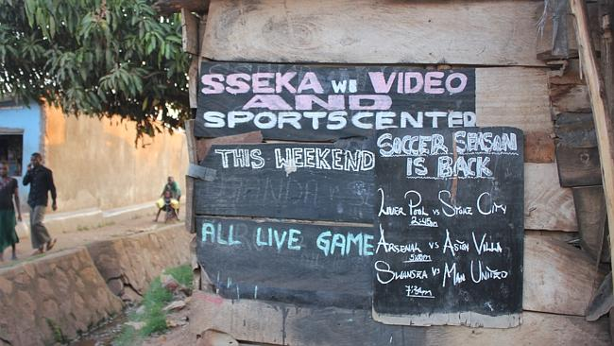
Why OBULAMU?
Health normally competes with other priorities in life – yet it is a basis for a better life.
Message fatigue among our audiences requires a new approach to trigger trust and attention
In order to prioritize health and develop intentions to act, we first need to engage in dialogue…
Position health in the wider context of LIFE…
Health is not sexy – LIFE is!!!

Slide 14
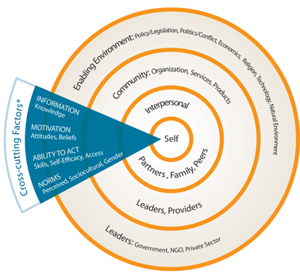
Determinants/Barriers To Action
Audience knows what the recommended behavior is [INFORMATION, KNOWLEDGE]
Audience believes that adopting the behavior will result in something they want. [MOTIVATION, BELIEFS ABOUT OUTCOMES]
Audience believes “I can do it.” [SKILLS AND SELF-EFFICACY]
Audience considers practice as “easy and convenient.” [SELF-EFFICACY]
The environment/home is set up to make the behavior easy. [ABILITY TO ACT, ACCESS, ENABLING ENVIRONMENT]
Audience perceives the practice as the “new norm.” [PERCEPTION OF SOCIAL NORMS]

Slide 15
Development Process
Use of existing national and IP data
Formative Research – Rapid Assessments
Participatory Action Research with target audiences – Action Media
Concept testing with audiences
Technical reviews by sector TWGs
Approval by MOH and UAC

Slide 16
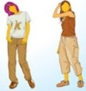


Life Stage Approach
Each of the four life stages includes cross-cutting audiences such as:
PLHIVs
CSWS
Fishermen
Uniformed Forces
Truckers
MSM
Lovers/Young Adults in relationships
Pregnant Couple
Family with Children
Caretakers of children U5
Adolescents
Key actions and linkage to services
Directly Influencing:
Best friends
Peers
Family members
Campaign champions (VHTs, health workers, police, pharmacists, teachers, business, religious and traditional leaders etc.)

Slide 17


Lovers
Pregnant Couple
Care Takers of U5s
Adolescents
Use condoms
Practice mutual fidelity – reduce sexual partners
Test for HIV and receive results
Men: Get SMC /women: Support SMC
Prevent unplanned pregnancies by using a contraceptive method of your choice.
Maintain discordant status through adherence to positive prevention and treatment
Go for TB screening and testing if your cough lasts 2 or more weeks.
Seek correct information on your sexual health and reproduction plans.
Recognize dangers signs of pregnancy
Make a birth preparedness plan (Attend ANC, save for birth items and transport) and talk to your partner about it
Begin ANC early and attend 4 times;
When there, demand IPTp 1-2; Test for HIV and & enroll into eMTCT if positive, receive malaria net and sleep under it)
Learn about the recommended newborn care practices e.g. Skin-to-skin contact, and early initiation of breast feeding.
Deliver at a health facility
Adherence to treatment and breastfeeding guidelines
Seek information on post-partum care which includes FP and Health Timing and Spacing of children.
Practice good nutrition for pregnancy and inform about breastfeeding (e.g, initiation within one hour)
Put baby to the breast within one hour after child birth (EIB).
Give your baby ONLY breast milk during the first six months (exclusive breastfeeding).
Feed the child 6-24 months a mixed diet in small portions and often (WHO Infant and Young Child Feeding Practices)
Breastfeeding women , feed on a mixed diet and try eating enough and well
Ensure that all children under 5 years sleep under a treated mosquito net
Recognize signs of childhood diseases (diarrhea, pneumonia) and seek advice or treatment.
Give ORS and Zinc for child with diarrhea.
Go to the health center and follow the full course of immunization for child.
Wash hands with soap and water before serving food, after using a toilet and after changing diapers.
Space the next pregnancy at least 24 months to ensure about three years between births
Treatment adherence for M&C
Seek correct information on how your body grows, and about your new fertility
Learn how to make good decisions and negotiate what you want to happen to you and your body (Life skills)
Learn how to prevent unwanted pregnancy and HIV and other STIs
Its harmful to have sex too early and to have children too early
Use a condom if sexually active.
Test for HIV and get the results.
Stay on treatment if positive
Boys: Get circumcised to help protect yourself from HIV
If your have a cough that lasts 2 or more weeks, go for TB screening and testing

Slide 18
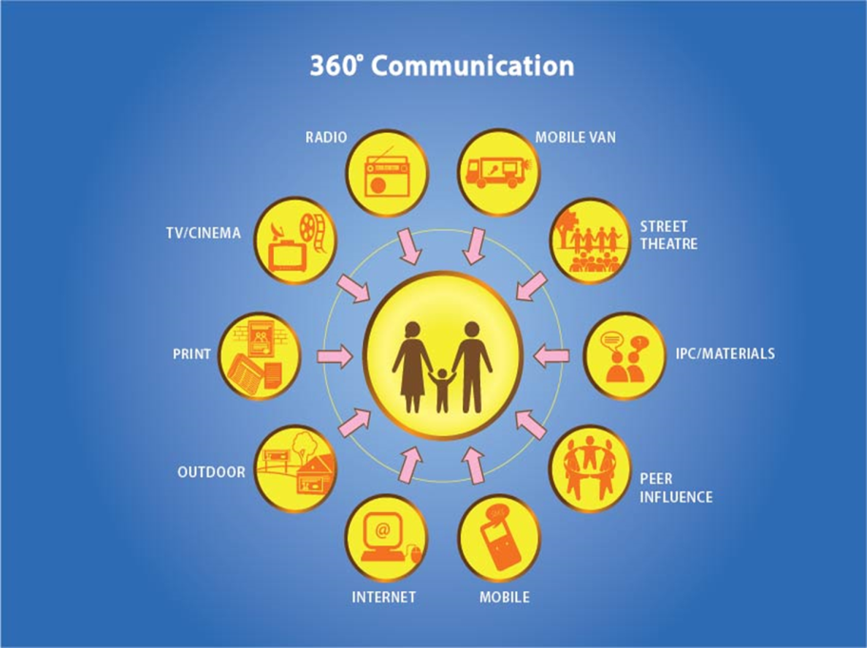

Slide 19
Execution
IPC- Community agents/champions:
  Health workers
  VHTs
  Linkage facilitators
  Religious leaders
  Journalists
  Peers/Peer leaders
  Organized groups e.g. Women, SACCOs
Mass Media
  Radio
  TV
  Print
  Social Media

Slide 20
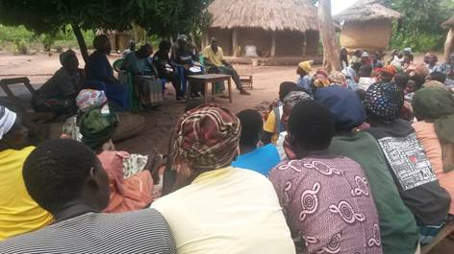
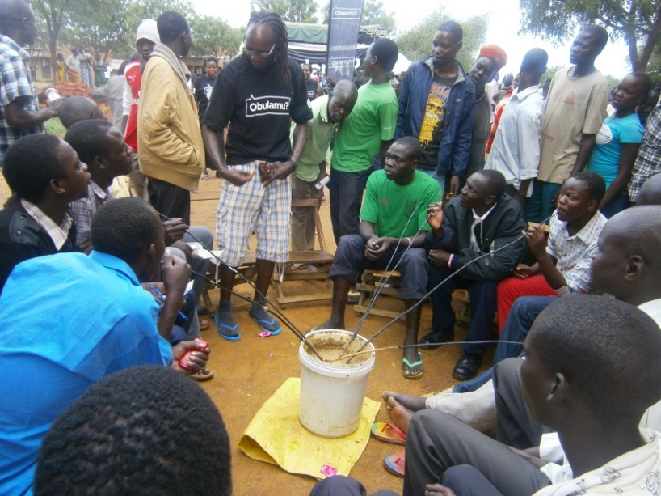
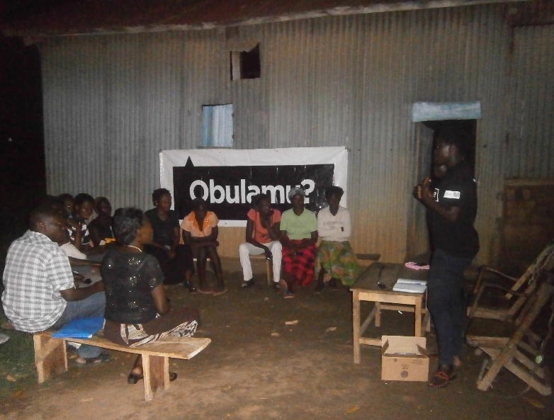
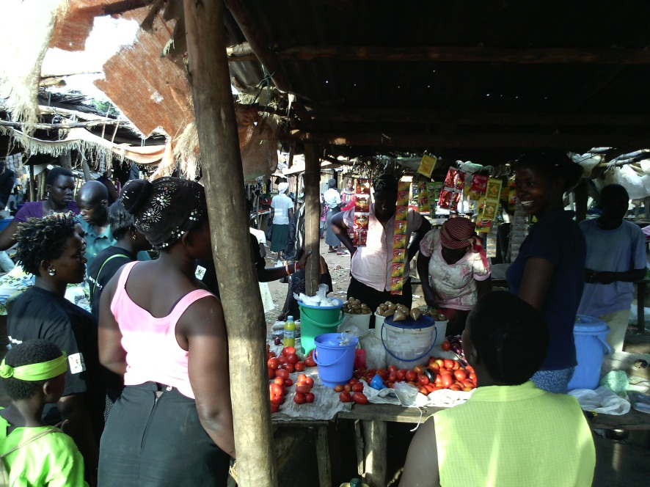
IPC Execution
Taking the conversation where people are…
Homes
Women groups
Markets
Bars
Water sources
Places of worship
Night clubs
Garages
Schools
Over 16,000 Champions orientated & deployed.
One-on-one & small group sessions - 4 new people per month/champion

Slide 21
Mass Media Execution
Targeted Placements
Hot spots
Buses
Health centers
1,000 Video halls
Billboards/street poles
Posters
DJ mentions
Talk shows
19 languages
Minimum of
10 exposures
Per day on radio
Radio stations
TV stations
Minimum of
4 exposures
Per day on TV
(prime time)

Slide 22
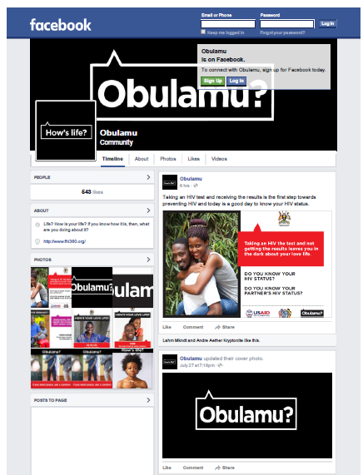
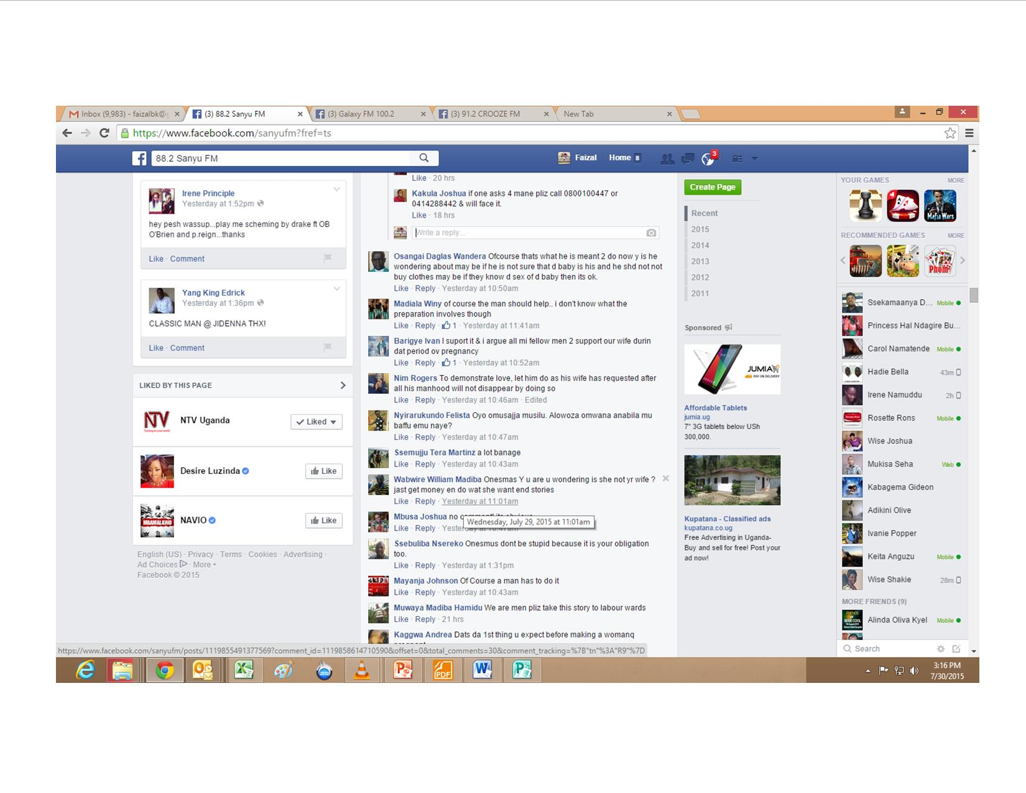
Social Media conversations

Slide 23
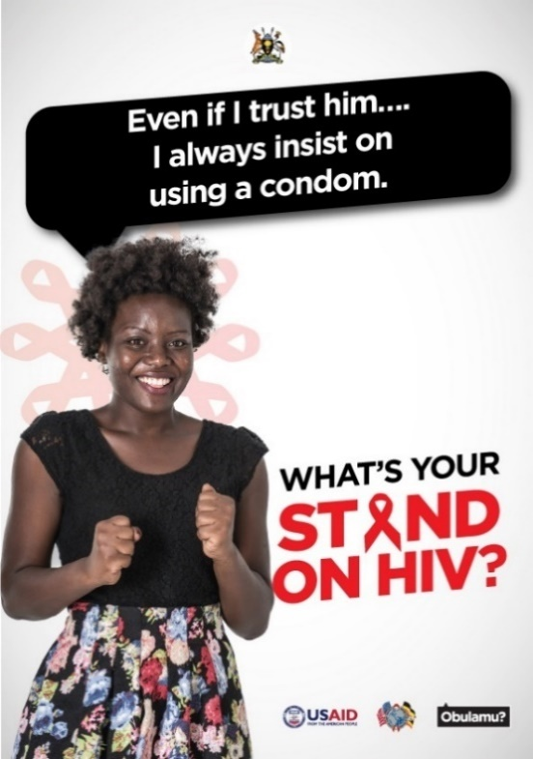
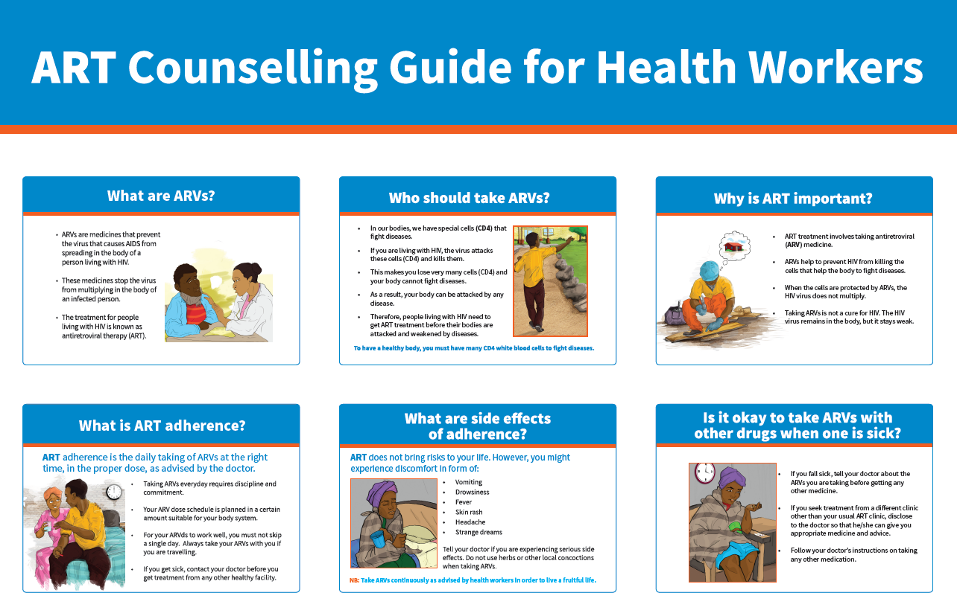


Print

Slide 24
Monitoring Evaluation and Learning
Follow-up of champion activities
Routine data from activity reports and After Action Reviews from IPC
Analysis on media reach and exposure
Service uptake data and reports from HMIS and partners
CHC Timeline surveys 1-2
National studies e.g. UPHIA, UDHS

Slide 25
Key Results And Lessons Learned
Overall, we have seen increased uptake of services and adoption of key health behaviours across the various thematic areas
There is a noticeable improvement coordination and standardization of SBCC messaging.
There is an increased prioritization of SBCC interventions at all levels
There is an improved capacity in form of knowledge and skills

Slide 26
Intention To Test For HIV And Receive Results In The Next Six Months
80.8% (Baseline)
92.1% (End-line)
Baseline n=3864, End-line n =3531
Notes:
Likely or very likely to get HIV counseling and testing in the next six months and to receive the results

Slide 27

Changes In Comprehensive Knowledge On Condom Use By Life Stage
Life stage 1
Life stage 2
Life stage 3
Life stage 4
Overall n Baseline 4012, End-line 3563
Notes:
Denominators
Baseline LS1 = 1134, LS2 = 381, LS3 = 511, LS4 = 745
Endline LS1 = 1023, LS2 = 255, LS3 = 386, LS4 = 554

Slide 28
Key Results And Lessons Learned
Audiences move on quickly; need to often refresh messages
Need differentiated approaches & tactics depending on audience needs
Interactive radio is more effective
Prescriptive/commanding communication by gate keepers to young adults doesn’t work
Tactical balance between IPC and mass media for reinforcement
Appropriate IPC structure for mobilization “Birds of a feather …..”

Slide 29
Recommendations
There is need to increase and sustain investment in SBC programs if we are to achieve Universal Health Coverage
Prioritize Health Promotion as a sustainable way of transforming the health service delivery sector.
SBC goes beyond messaging around disease area but the entire human ecosystem which needs an enabling environment

Slide 30


