Slide 1



Building support for community health initiatives to achieve UHC in Uganda:
The Living Goods Uganda Experience
November 2019
Presentation to the Health Promotion Conference
Dr. Nambatya Nsubuga
Deputy Country Director, Living Goods
UHC Co-Chair Africa
Living Goods Uganda – On Boarding Presentation
Last updated: June 2018

Slide 2
Our vision: Living Goods envisions a world where every family easily accesses the healthcare they need to survive and thrive
Our mission: Living Goods aims to promote health and save lives at scale by supporting digitally empowered community health workers. We work with governments and partners to leverage smart mobile technology, rigorously strengthen performance and relentlessly innovate to deliver cost-effective, high quality health services.
Notes:
Ambitious

Slide 3
The four policy implications to attain UHC and thus strengthen PHC
Increase proportion of costs covered by domestic/ public funds;
  Government financing of vital programmes;
  Reduce direct user-charges;
  Private/Social H. insurance.
Increase the services of good quality;
  Service package & standards
  Health workforce
  Medicines & effective regulation
Expand the population groups benefiting from the services;
  Progressively cover all groups
  Start with most in need;
  Control population growth;
Build resilient community systems to sustain coverage
  Invest in affordable provisions
  Sustain demand for vital programs
  Manage technologies for sustainable coverage
  Source: Adopted from WHO
Notes:
Bring to life how we work in the countries

Slide 4
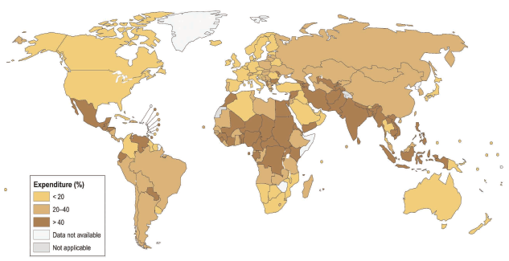
Financial risk protection is patchy
Where out-of-pocket expenditure is high in relation to total health expenditure; 150M people suffer catastrophic expenditure each year, WHO 2016
Notes:
LIZ
Bring to life how we work in the countries

Slide 5
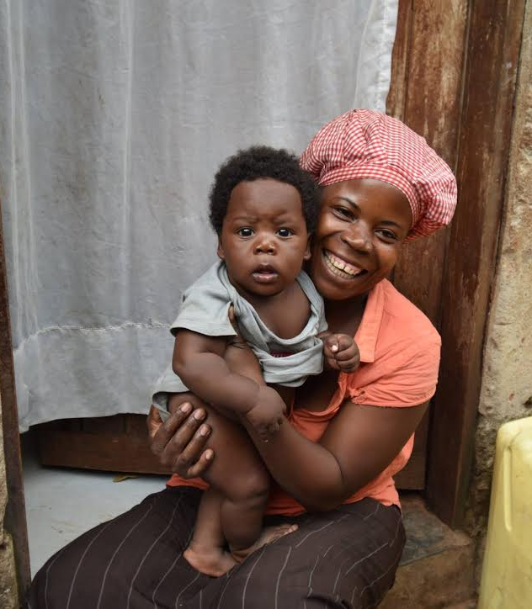
“In the middle of difficulty lies opportunity.”
Why invest in community health?
~ Albert Einstein
In many low income countries, 1 in 3 families will lose a child before their 5th birthday.
Public health facilities are overburdened and costly.
More than 4,000,000 health workers are needed.
At private pharmacies, prices can run over 300% of manufacturing cost, and counterfeits are rampant.

Slide 6
WHO CHW Policy Interventions
Using a health system approach, the guideline groups issues and recommendations under three broad categories of policy interventions targeting CHWs, focusing on: Selection, education and certification: Selection of CHW should be criteria based; Content and duration of pre-service training should be tailored to context and balance theoretical knowledge and practical skills; and certification should be competency based. Management and supervision: CHW programs require integration into local and national health systems and plans, including: supportive supervision; appropriate CHW remuneration; written contracts, working conditions and rights; and potential for career advancement. Integration into and support by health systems and communities: Successful CHW programs are integrated in the communities served and the health systems they connect to. Engaging communities in defining needs, selecting and holding CHWs accountable, and mobilizing resources improves community ownership and CHW motivation and performance.

Slide 7










Our Approach
Working with government and communities to deliver PHC services to improve health outcomes and cut health care costs since 2008
Communities
Health Facilities
Living Goods support Government CHWs to effectively close the loop
x 100
Significant unmet health need
High mortality: child, neonatal deaths to preventable cause
High fertility rates
Poor nutrition outcomes
Risk of outbreak
Overburdened health staff
Rampant stock outs
Long queues for patients
Located too far away for many families
Pre and post service training
Essential Medicines and FP commodities available
Tech-empowered end-to-end
Strong supervision
Compensation
Hand in hand with the MOH
Closing the loop through surveillance, home visits and referrals

Slide 8
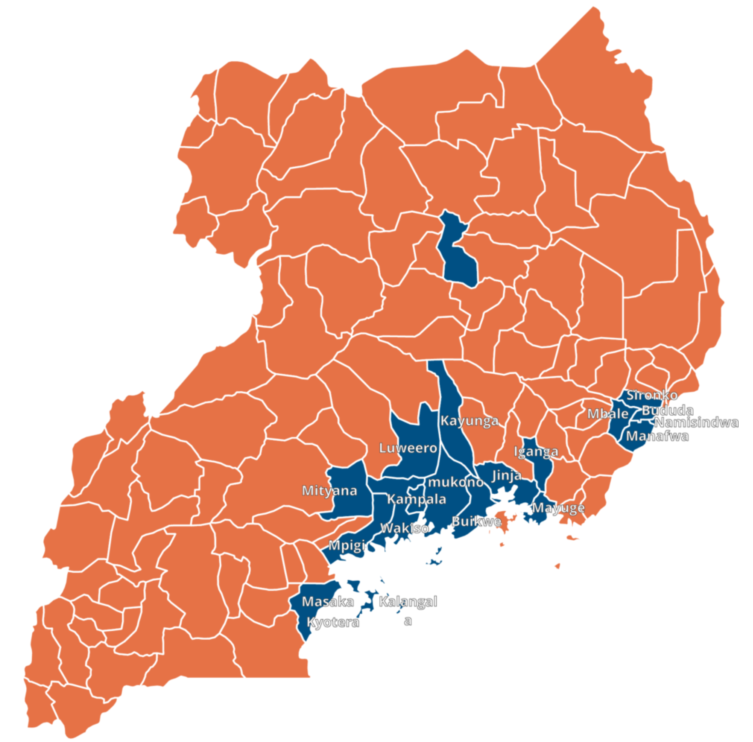
Living Goods is now directly supporting more than
4,000 CHWs in 19 districts
Notes:
As at Dec 2018

Slide 9


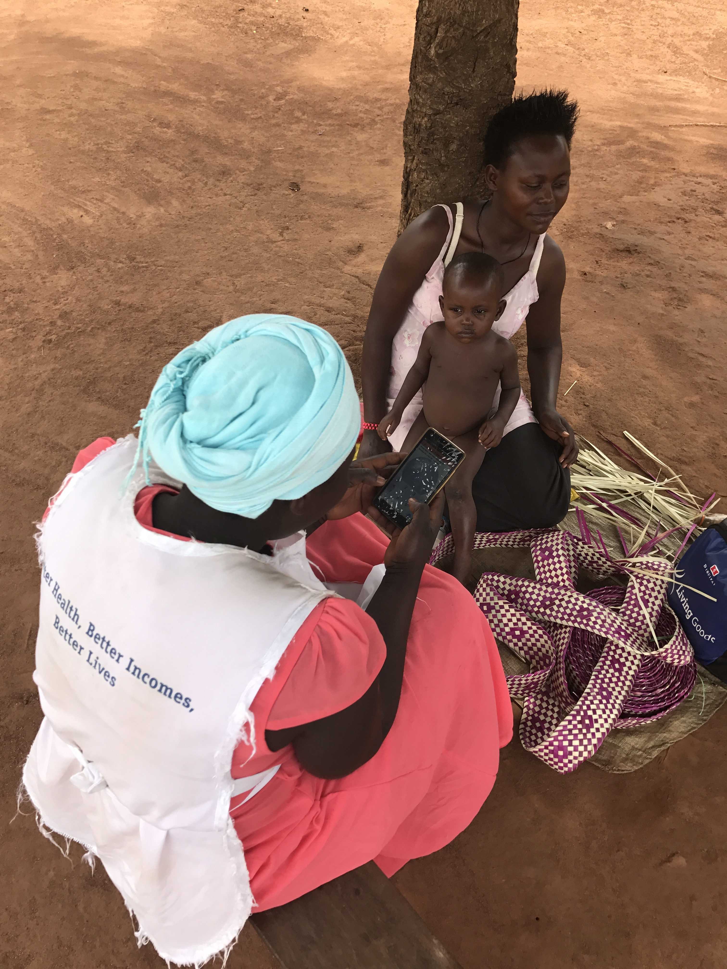



CHWs are delivering services to address the leading preventable causes of neonatal, maternal & child deaths
Healthy Pregnancy
Newborn
Survival
Digital technology
Performance-based incentives
Family Planning
Childhood
Diseases
In-Stock CHWs
Performance Management
Immunization
Nutrition
*The study was independently sponsored by CIFF. IPA surveyed 8,000 households over 3 years across 214 villages.
2

Slide 10
We work directly and with government and partners to help CHWs reach their full potential to deliver quality PHC services
Select
Train
Equip
Manage
Incentivise
Community
referrals
Literacy and
numeracy tests
Interviews
Replace low
performers
Based on gov’t curriculum
Three weeks initial
Monthly in
services
Hands-on
learning
Mobile tools
Business in
a bag
Uniform
Smart phone
Inventory loan
Targets
Real-time data & dashboards
Field supervision
checklists
Random quality
checks
Retail margin on sales
CHW performance
incentives
Performance based compensation for all staff

Slide 11


CHWs are all equipped with Smart Phone to enhance their ability to deliver quality PHC services
Disease surveillance
Geo tracking of disease incidences and analysis
Health promotion
Videos
Referral
Referrals tracking and follow ups
Treatment
Digital diagnosing
Biosensors
Disease prevention
Mobile learning
Leadership/ governance
Data informed policy/ decision making, real-time performance tracking)
Products, supply chain, logistics
POS, stock management, warehouse management etc.
Health workforce
Supervision & performance management
Research and information
Data collection and analysis
Financing
Mobile payments, incentives
Notes:
Tech can support CHWs to perform better in the field
Tech use can improve performance management of CHWs
Collection of timely, accurate data and ease DQA
Tech can guide CHW supervision and track supervisor performance
Ability to share data with national level platforms like DHIS2
Provide an easily adaptable platform to undertake quality improvement and
innovation

Slide 12

A J-PAL randomized control trial revealed Living Goods is achieving a
27%
reduction
in under-five
mortality 28% reduction in neonatal mortality for less than $2 per person annually
The study also found a 7% reduction in
under-five stunting.
The study was independently sponsored by the Children’s Investment Fund Foundation. IPA surveyed 8,000 households over 3 years across 214 villages. Mortality rates improved across income groups at similar rates.
Note: Published paper accessible here https://www.aeaweb.org/articles?id=10.1257/app.20170201
Notes:
Proof of impact

Slide 13
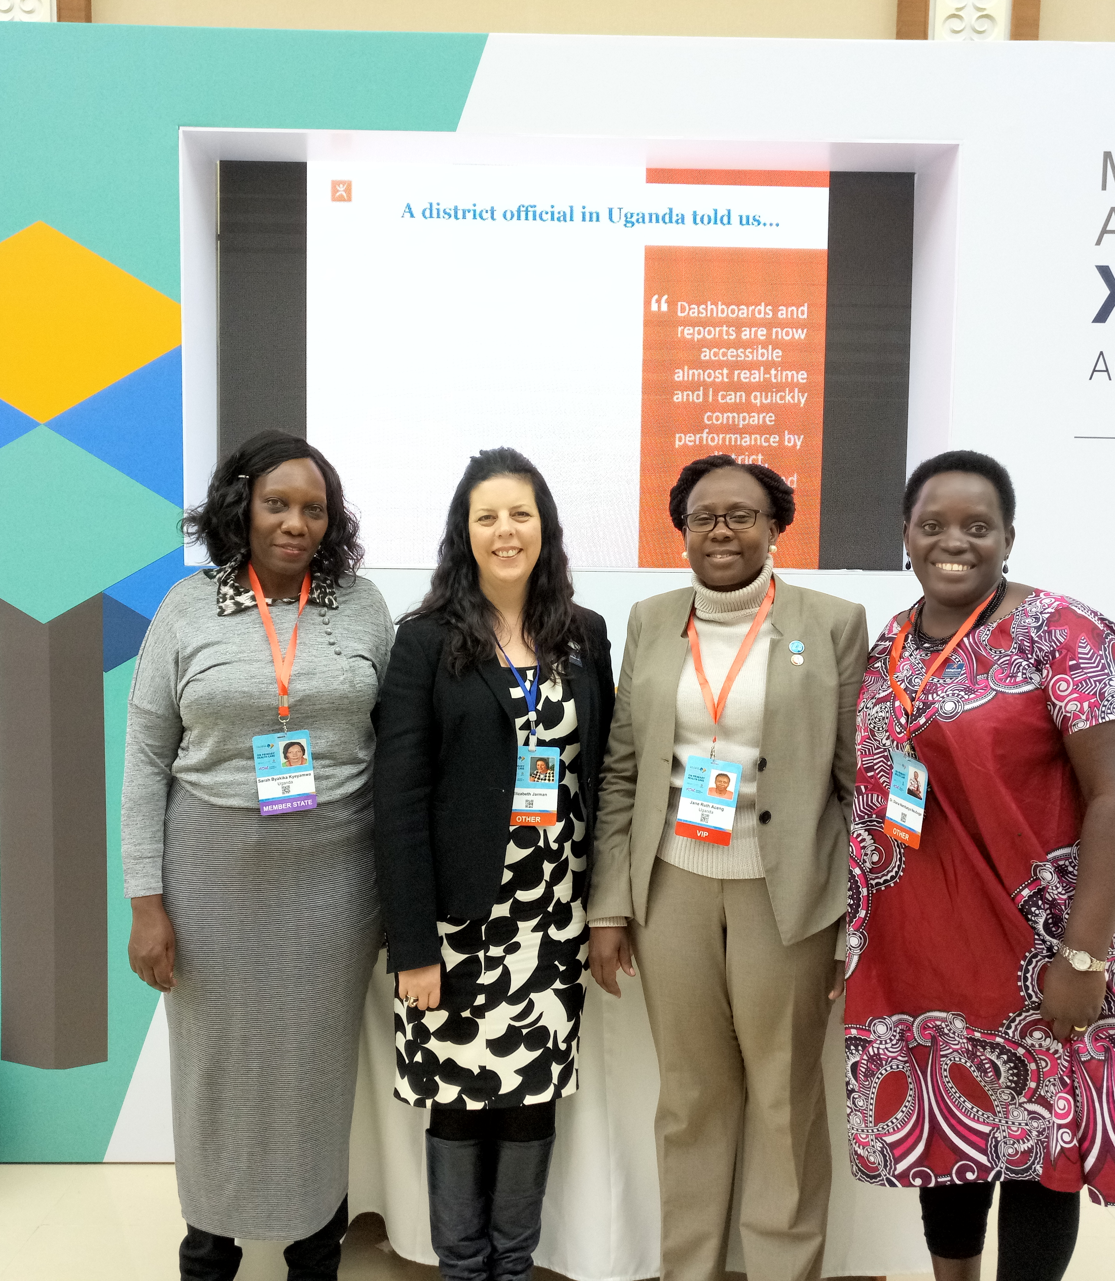
Communities at the heart of UHC
From Alma Atar-Astana-WHA-UNGA
Key nuggets
Community Health is paramount for PHC and UHC
Leadership a critical and great catalyst for UHC
UHC Roadmap: Opportunity for multisectoral engagement
Community Health Framework
Champions: Our Minister has been recognized as a Global Good will Ambassador for UHC
Highly Technical Staff at MoH
Sub national level coordination by Chairperson of DHOs and Chairperson LCV
CSOs Platform
Partners: Coordination mechanism for CH

Slide 14











Made possible by extraordinary partners

Slide 15
Thank you

Slide 16
Living Goods Theory of Change
Key
MISSION: Living Goods aims to promote health and save lives at scale by supporting digitally empowered CHWs. We work with governments and partners to leverage smart mobile technology, rigorously strengthen performance and relentlessly innovate to deliver cost-effective, high quality health services.
Activity
Output
Intermediate outcome
Final outcome
DOING
LG Directly Managed CHW Networks
SEE DETAIL IN LG DIRECT THEORY OF CHANGE
STRONG CH SERVICE DELIVERY
Digitally empowered, nationally scaled, high quality, cost-effective CHW cadres expanding equitable health coverage and delivering proactive, quality essential health services and education to underserved communities
INCREASED ACCESS&DEMAND
Evidence-based RMNCH health services & uptake of key behaviors
STRENGTHENED GOV’T CAPACITY IN CH
at national & sub national level to manage and deliver
Essential CH Program Elements:
Paid
Supervised
Equipped & supplied
Digitally empowered
SCALE
MANAGING
Government Contracted Delivery of CH Services to LG
CATALYTIC IMPACT
Other
countries invest in national high-quality community health systems saving lives and improving health outcomes globally
IMPROVED HEALTH OUTCOMES
SUSTAINED IN PRIORITY COUNTRIES
Maternal & Child Mortality
and other health outcomes
ADVISING
Technical Assistance to Governments and NGOs
INCREASED, EFFECTIVE & SUSTAINED CH FINANCING
Global and LG Focus Countries
LG STRATEGIC OBJECTIVES
STRENGTHEN
INCREASED GOV’T POLITICAL WILL TO INVEST IN CH
leading to increased domestic financing for PHC and CH
SHARING
Innovations, Research & Learning to inform Policy & Practice
STRONG CH SYSTEMS
Integrated with PHC Systems
mHealth, Supply Chain, Performance Management, M&E, Planning, Governance
INCREASED GLOBAL DONOR WILL AND FINANCING FOR CH
SPREAD
ADVOCATING
Global & LG Focus Country Advocacy
STRONG CH POLICY
Global and LG Focus Countries
CH Policy, Guidelines, Regulations
UNIVERSAL HEALTH COVERAGE
SUPPORT: FUNDRAISING, FINANCE, TECHNOLOGY, PEOPLE & CULTURE, OPERATIONAL EFFECTIVENESS, QUALITY ASSURANCE
Notes:
In term of what to say on this slide. I think it is important to demonstrate that if key pillars of effective CH are in place and implemented this will dstrengthen PHC and then thus UHC

