Slide 1
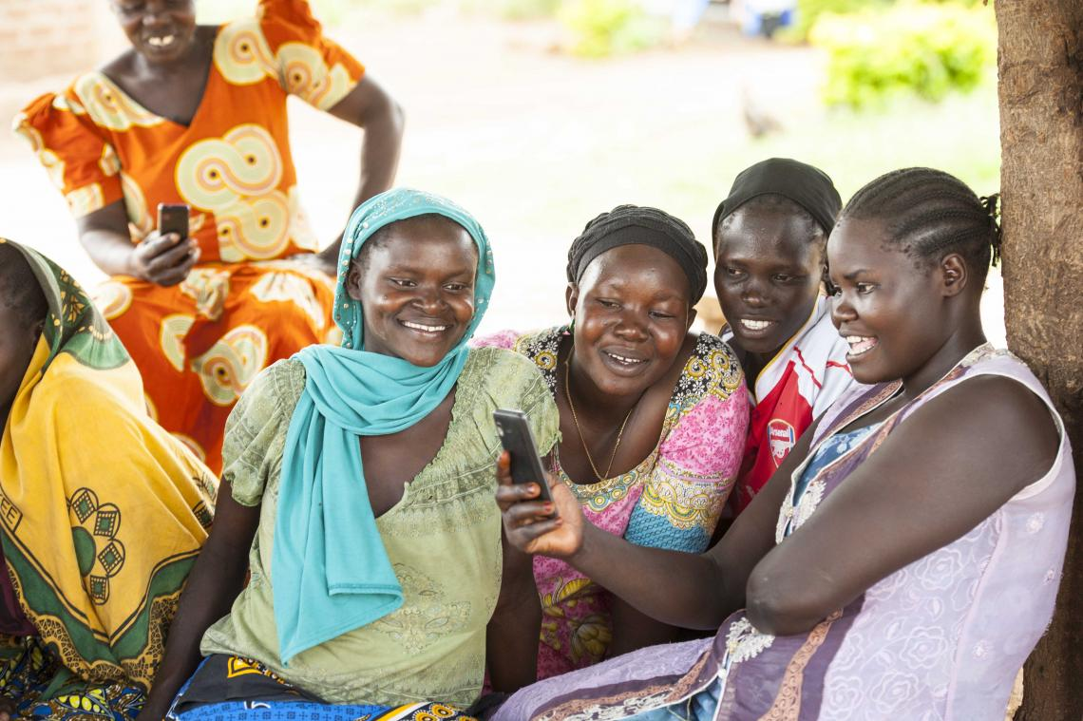
Technology for Health
Promotion
Susan Serumaga, Sen. ICT/T4D Officer, UNICEF

Slide 2
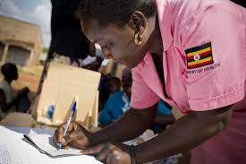
Enabling Environment in Uganda
National Broadband Policy
National ICT Policy 2014
Uganda National e-Health Policy and Strategy
Data Protection and Privacy Policy 2019

Slide 3
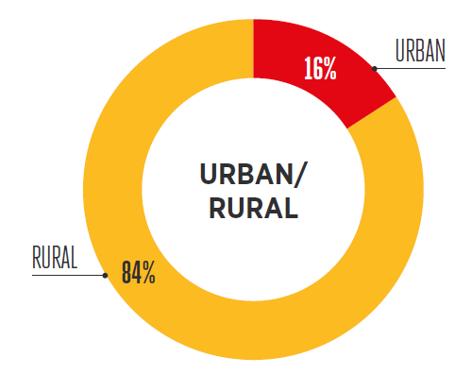
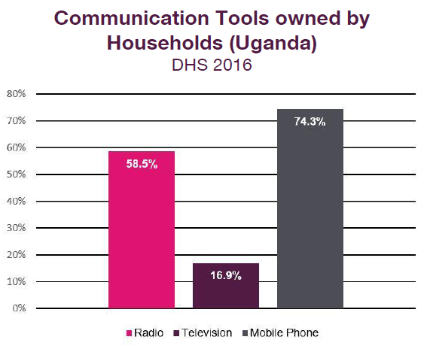

Enabling Environment in Uganda
Population:
45 Million
Population covered by a mobile network
78%
Mobile Subscribers: 19.8m
46 %
use mobile Internet
16 %
Smartphone adoption
Source: GSMA

Slide 4
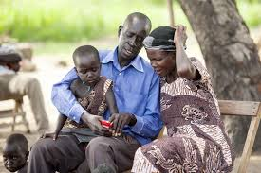
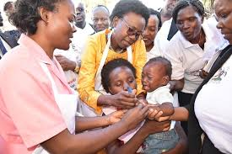
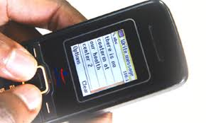
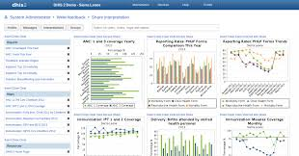
Technology: A tool promoting Health in Uganda
74.3%
58.5%
Personal Care
Targeted Communication and Messaging
Monitoring, Reporting, Data Visualization
Dissemination and feedback messaging (uReport, mHealth Hotline)
Behavioural change communication (Family Connect, Linda Mama, mHero
Surveillance tools, mTrac
Monitoring and Detection of disease outbreaks; Epi Info VHF
Data visualization for decision support; DHIS2
Social Media applications; WhatsApp Doc

Slide 5
Partnership for Health: A UNICEF Experience
1.Design with the user
9. Be collaborative
2. Understand the existing ecosystem
8. Address privacy & security
Collaboration
Partnership Resource Mobilisation
3. Design for scale
Government UNICEF
7. Reuse and Improve
4. Build for sustainability
Capacity Building
Technical Support
6. Use Open standards, Open Data, Open Source & Open Innovation
5. Be Data Driven

Slide 6
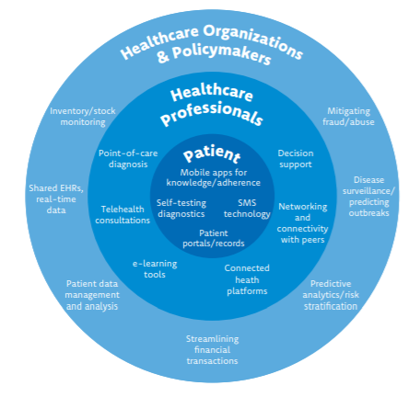
Support for Health Systems Strengthening
Supply Chain
Health Providers
Access to Data
Access to Information

Slide 7
Moving the health promotion agenda forward
Integration and Interoperability
Capacity building through support for startups and the local innovation ecosystem
Accessibility and Affordability (Last Mile infrastructure/ devices)
Data Use / Visualization at all levels including community level
Equity: Content in local languages and IVR solutions
Partnership/Collaboration/ Ownership (Public/Private Sector / Government)

Slide 8
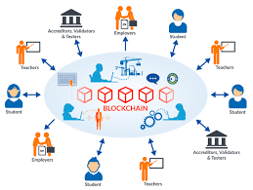
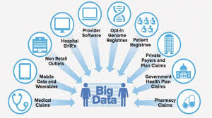

Emerging Technologies

Slide 9

Thank you

