Slide 1
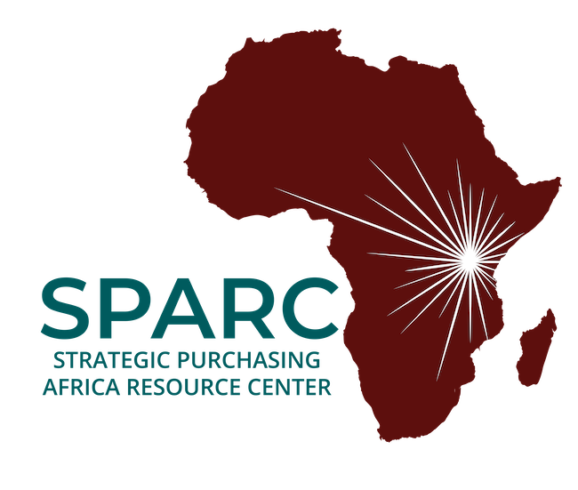
Sustainable Financing for Health Promotion
Dr. Nkechi Olalere MBBS, MBA, MPH
Executive Director
Strategic Purchasing Africa Resource Center (SPARC),
Amref Wilson Airport, Lang’ata Road,
Nairobi, Kenya.

Slide 2
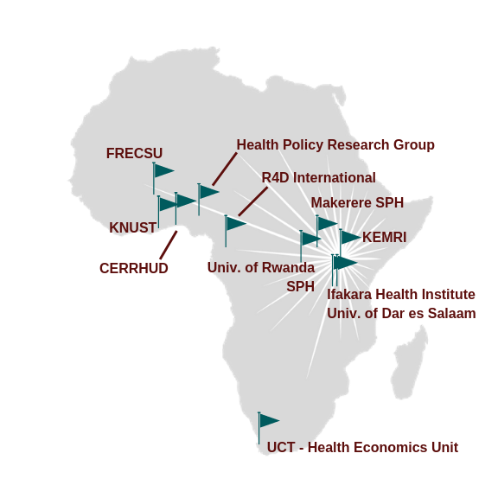
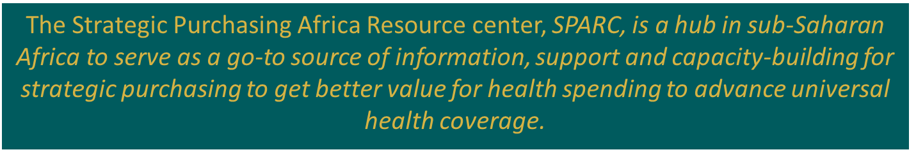
About SPARC
Leverage and expand
Linkages and partnerships
Connect experts for peer learning

Slide 3
Key Decision Points for Strategic Purchasing
What to buy?
Who to buy from?
What to pay and how to pay?
Most countries wish to provide a comprehensive benefit package to their citizens. Given limited funds, this may not be feasible. How do we design a package that speaks to the priority healthcare needs of the population?
Public vs private Service range Location Quality Quantity Price
Tariff How can we use our policy objectives to pay providers and provide an incentive for improved focus on health promotion? Payment methods What payment mechanism provides an incentive for providers to increase their focus on health promotion?
Underlying all this is the need for data collection and use for decision-making

Slide 4
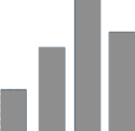

Focusing on what to buy…
According to the WHO for every US$100 of public budget in Africa, $16 goes to health services, about $10 is spent and less than $4 of that goes to the right health services.
Competing health priorities
Challenges with resource allocation
Inconsistent service delivery
Limited financial resources
How does a strategic purchaser make the right decisions?

Slide 5
Some Criteria or Coverage Inclusion
Burden of Disease
Current Spending
How well interventions are currently delivered by existing providers; for instance, in terms of price and quality
The existing burden of disease categorized by a range of variables e.g. age, gender, economic status, geographic location
How cost-effective the available interventions are
How much money is currently being spent on different health services
Cost-Effectiveness
Price and Quality
Strategic purchasing prioritizes primary health care by protecting its funding and incentivizing their provision

Slide 6
Why Should PHC Be A Priority?
Primary health care ensures people receive comprehensive care - ranging from promotion and prevention to treatment, rehabilitation and palliative care - as close as feasible to people’s everyday environment.
A primary health care approach, which draws in a wide range of stakeholders, can respond to rapid economic, technological, and demographic changes, all of which impact health and well-being.
1
Stronger primary health care is essential to achieving the Sustainable Development Goals (SDGs especially SDG 3) and universal health coverage
2
PHC has also been shown to be a good value investment, as there is evidence that quality primary health care reduces total healthcare costs and improves efficiency by reducing hospital admissions.
3

Slide 7
Is PHC An Avenue For Management of Non Communicable Diseases?
People with NCD or at risk of developing one, require long-term care. Such care can be delivered equitably only through health systems based on primary health care
80%
Equity and Sustainability
Healthcare costs due to NCDs
  People with NCDs may be asymptomatic. PHC is the most frequent entry point into the health system and offers the greatest potential to detect high-risk individuals who may be visiting health services for other health reasons.
Early Detection
3%
Feasibility and Affordability
  The scale of NCD burden means that it is no longer feasible to manage mainly through specialists. The total risk approach is suitable for implementation by non-specialist health workers at primary health care level.
Healthcare budgets for prevention

Slide 8
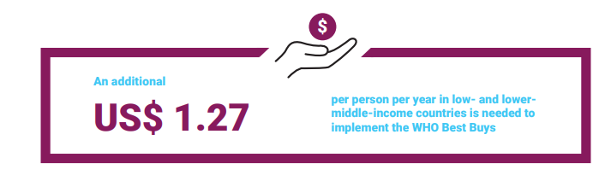
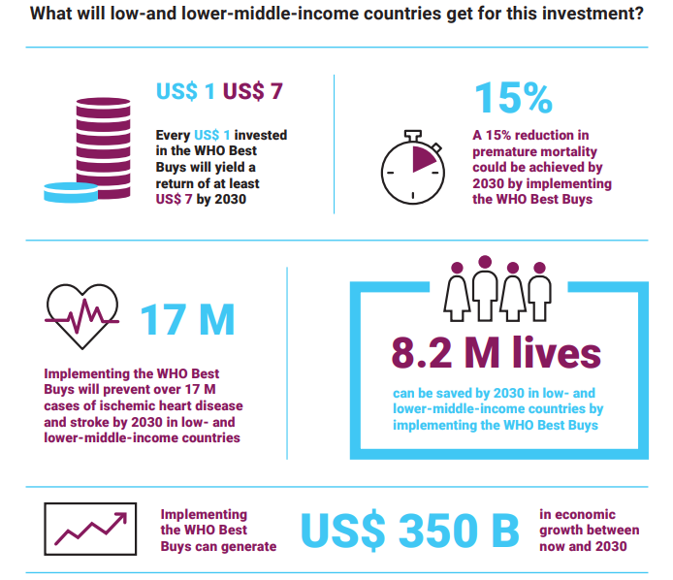
Source: WHO. Saving lives, spending less A strategic response to non-communicable diseases

Slide 9
Financing Mechanisms For Health Promotion
Most funding for public health promotion come from government funding and external sources. Little from health insurance
External Sources
In Central America, for example, the Central America Diabetes Initiative (CAMDI) was founded as the outcome of a regional workshop on diabetes in 2000 (financed by PAHO and DOTA).
Mix
Social security, tax-based payments and private health insurance
Central America
Mexico
Excise Taxes
    New Zealand - tobacco,
    Denmark - a variety of products, including motor vehicles, energy, spirits and tobacco products
Sample Countries
Public funds
    Central and local government budgets
New Zealand and
Denmark
Mongolia
Ear Marked Taxes
    10% price increase of harmful products reduces overall consumption by 4% in developed and 8% in developing countries
Thailand and Australia
Denmark and Northern Ireland
Specialized institutions
    Denmark – 2 specialized institutions
    Northern Ireland - Health Promotion Agency

Slide 10
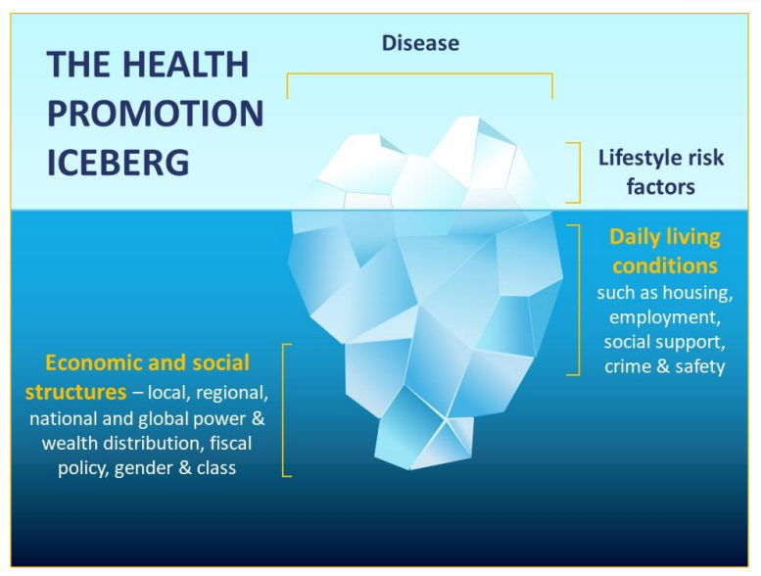
(WHO)
Non-Financial Investments For Health Promotion

Slide 11
Thank you.

Slide 12

Dr. Nkechi Olalere MBBS, MBA, MPH
Executive Director
Strategic Purchasing Africa Resource Center (SPARC),
Amref Wilson Airport, Lang’ata Road,
Nairobi, Kenya.
Follow SPARC on:
W: https://sparc.africa

