Slide 1
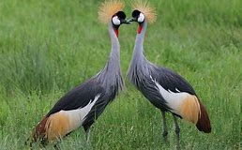

‘The Great Escape’
Health promotion, prevention and communities
Dr. Githinji Gitahi
Global CEO – Amref Health Africa
Co-Chair UHC2030
Kampala, Nov 2019

Slide 2
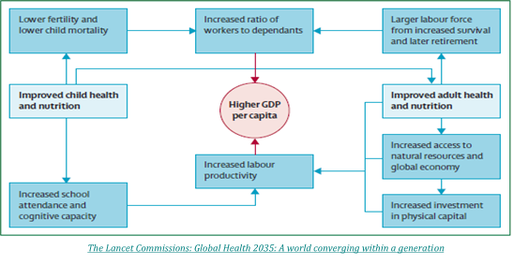
The Great Escape: UHC and GDP
Low fertility and low child mortality
Increased ratio of Workers/Dependents
(Demographic dividend)
Larger labour force from increased survival and later retirement
Increased adolescent and child health and nutrition
UHC
Higher GDP per capita
UHC
Increased adult health and nutrition
Increased access to natural resources and global economy
Increased labour productivity
Increased school attendance and cognitive capacity
Increased investment in physical capital
Adapted from:

Slide 3
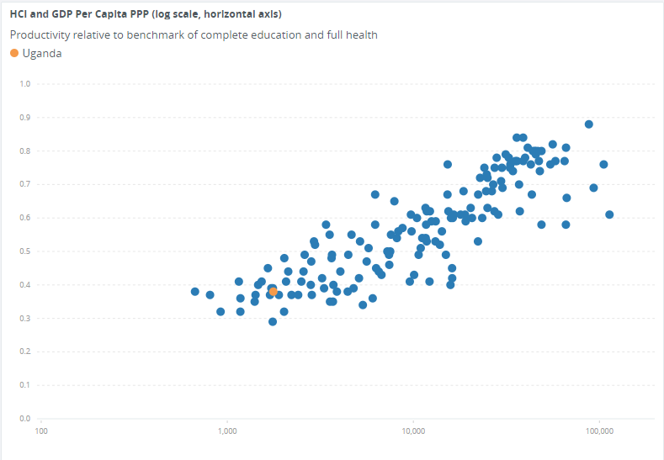
Uganda's Human Capital case – Health and Education
A child's potential by 18 years in Uganda is 38%
What eats away 62% a child's potential?
A child's lost potential by 18yrs in Uganda
Human capital Index
GDP per capita (USD)

Slide 4

UHC – Single most important human capital investment – Healthy kids learn and healthy adults earn
Equity NOT Equality
100% covered but for?
Optimal NOT Excellent

Slide 5
Health vs Healthcare
Courtesy: Global Health Science and Practice 2014 Vol 2 No 1

Slide 6
UHC means?
A: Universal Healthcare Coverage?
UHC
=
B: Universal Health Coverage?

Slide 7
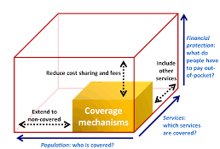
So what's UHC?
What population is covered against financial costs?
What services are protected against financial costs?
How much of the services are protected against financial costs?
Increased access to health services
Reduced out of pocket expenditure
Reduced catastrophic expenditure
Reduced impoverishment

Slide 8
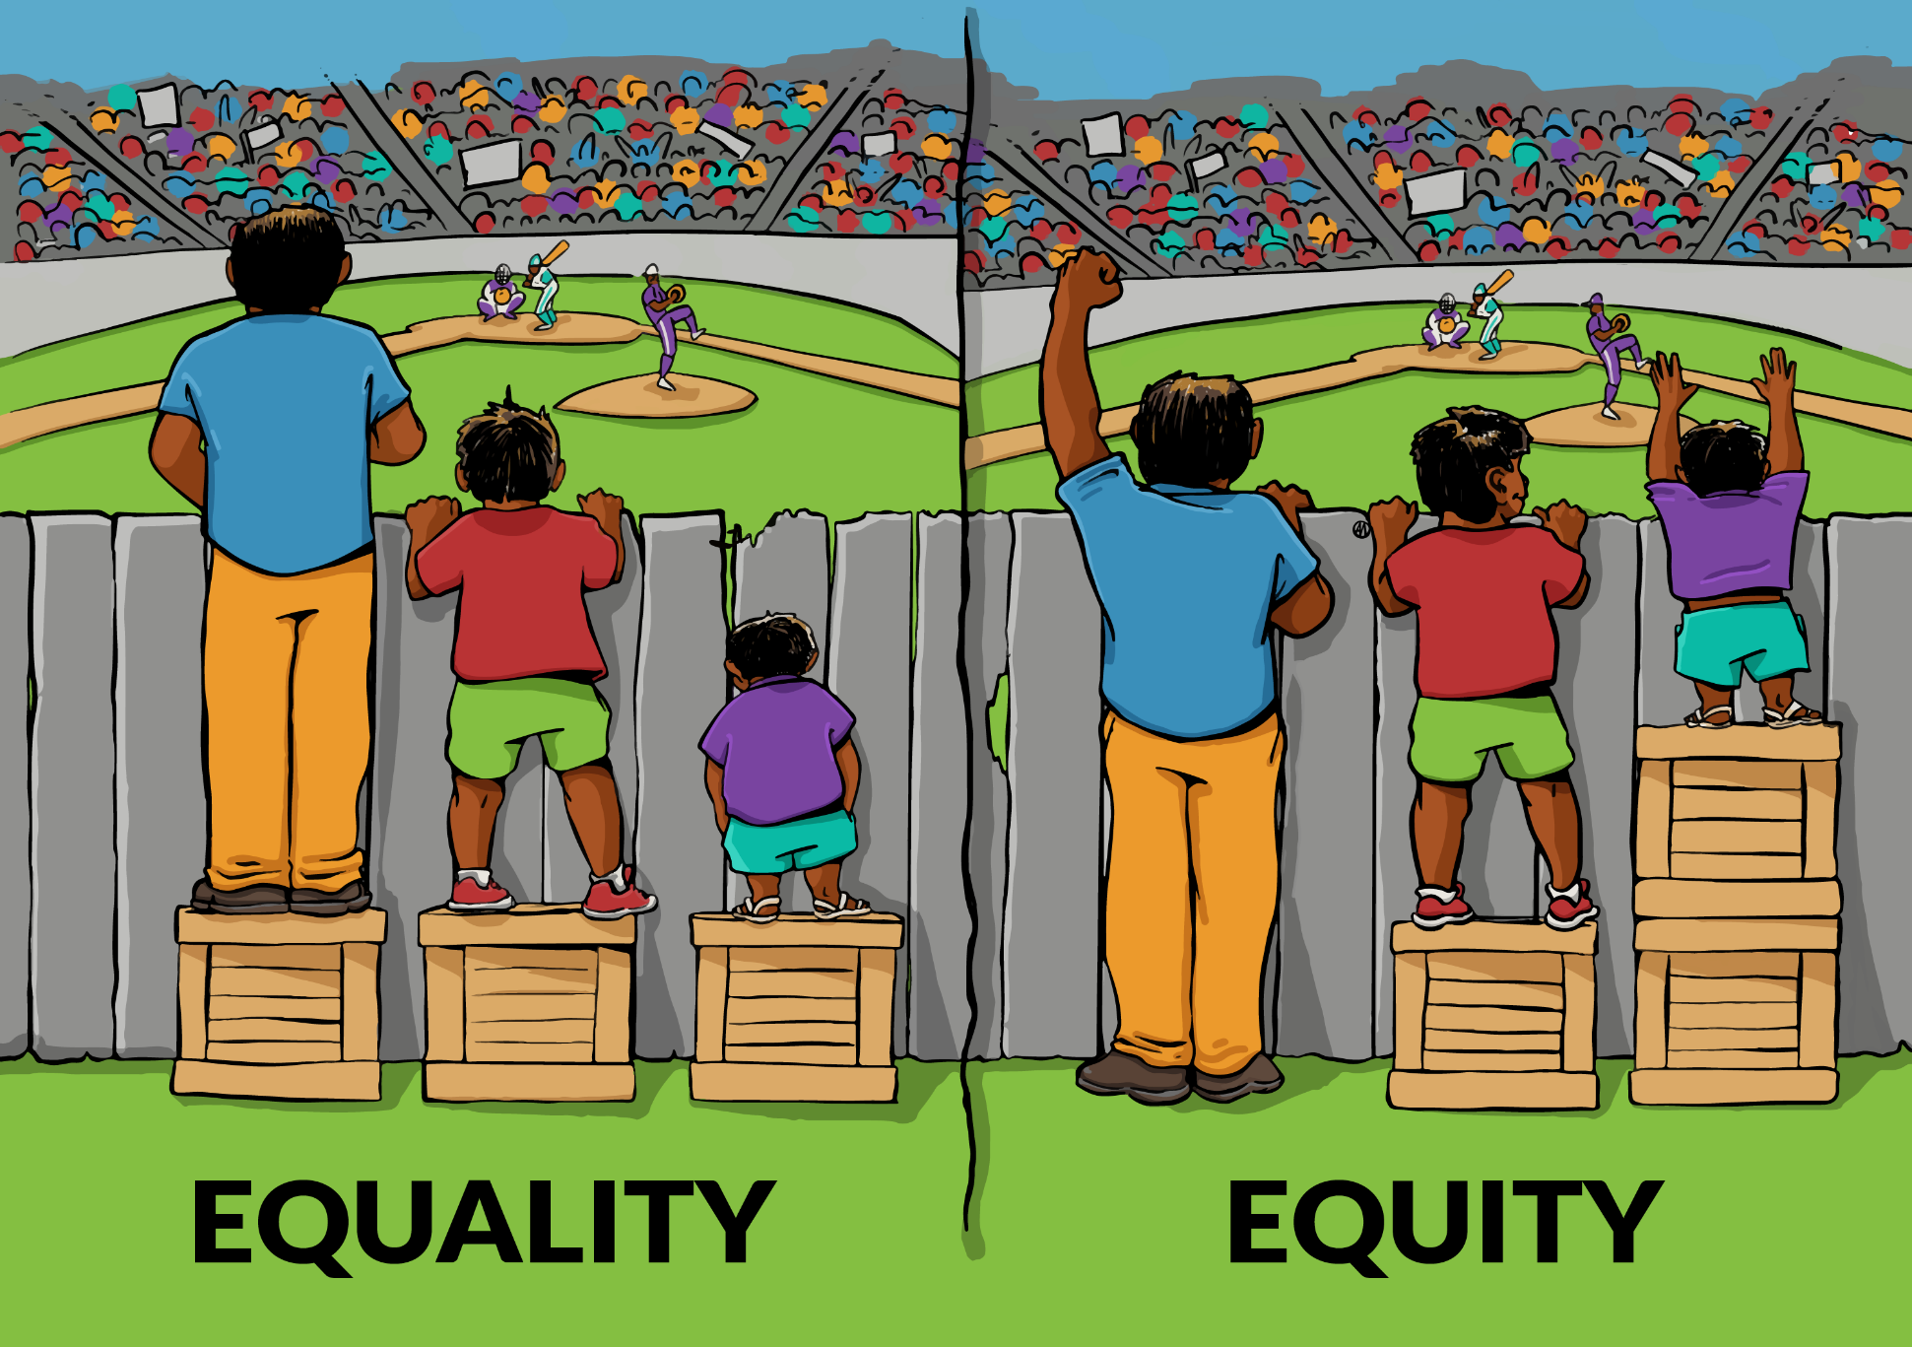
…….and driven by Equity not Equality
UHC
UHC
UHC
UHC
UHC
UHC
UHC
UHC
Courtesy Interactive Institute of Social Change

Slide 9
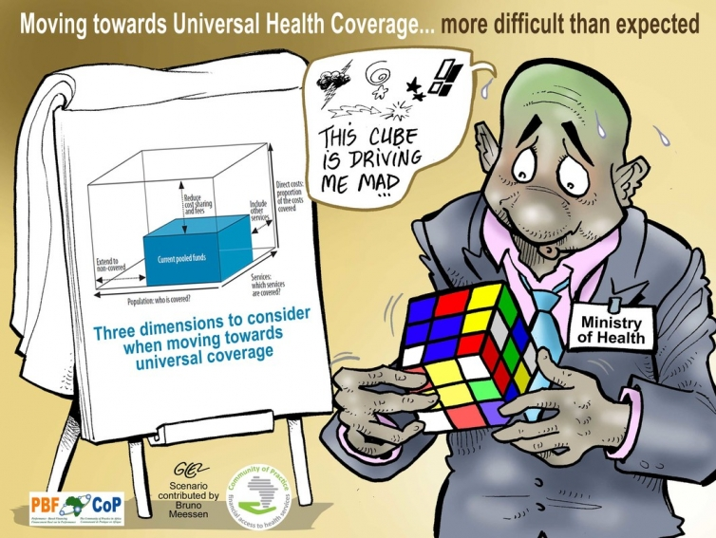
How do we work within this reality?

Slide 10
Not enough money!
The WHO High Level Task Force recommends investing a minimum of
$86.30 per capita of Domestic Government Health Expenditure to purchase a set of Primary Healthcare interventions and services
The conversation on domestic resource mobilization is not about ‘aid or no aid’ but about alignment; FROM FUNDING TO FINANCING – Country led

Slide 11
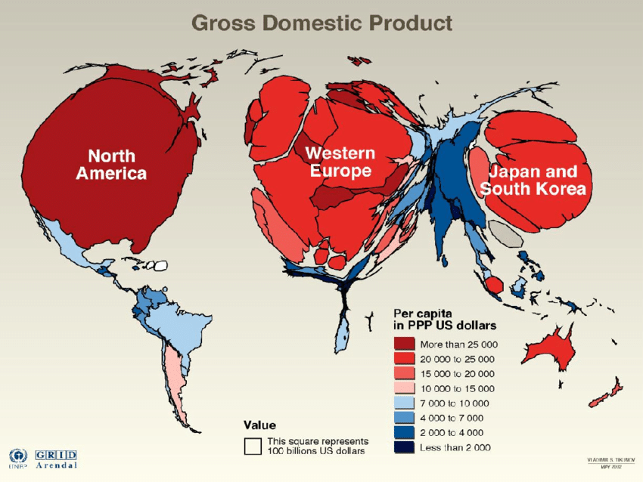
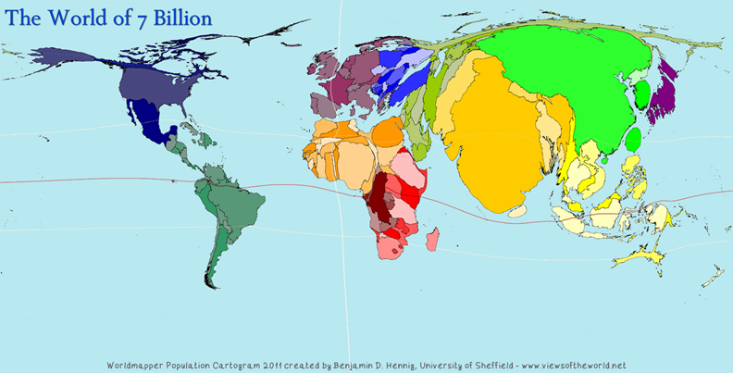
The African economy is small and population is big…..
2.7% of the Global GDP
17% of the Global population
Map courtesy of UNEP
Map courtesy of Uni if Sheffield

Slide 12
Lets see how much we can get…..
Netherlands
$850 B
$170 B
Denmark
$325 B
$65 B
SSA
$ 1700 B
$51 B
$26 B
$10 B
$340 B
17M
5.4M
1,000M
$51
$1,800
$1,500
Actual Tax/GDP ratio is
39%
Actual Tax/GDP ratio is
46%!
Actual Tax/GDP ratio is
15%
Assumptions
GDP
Tax at 20% ratio
Health all. at 15%
Population
Per capita public allocation
Non-resource taxes as % of GDP
Courtesy: Githinji Gitahi
*Actual about $4000
Actual about $4000
$86 recommended for Universal access to primary health services in LICs

Slide 13
Many African countries far from these targets. Why?
Red = Less than $86 target
Red = Less than 15% target
Source: Africa scorecard for Domestic financing for health 2018
Between 2005 and 2015, Government spending in health as % of total government expenditure declined in 21 countries!

Slide 14
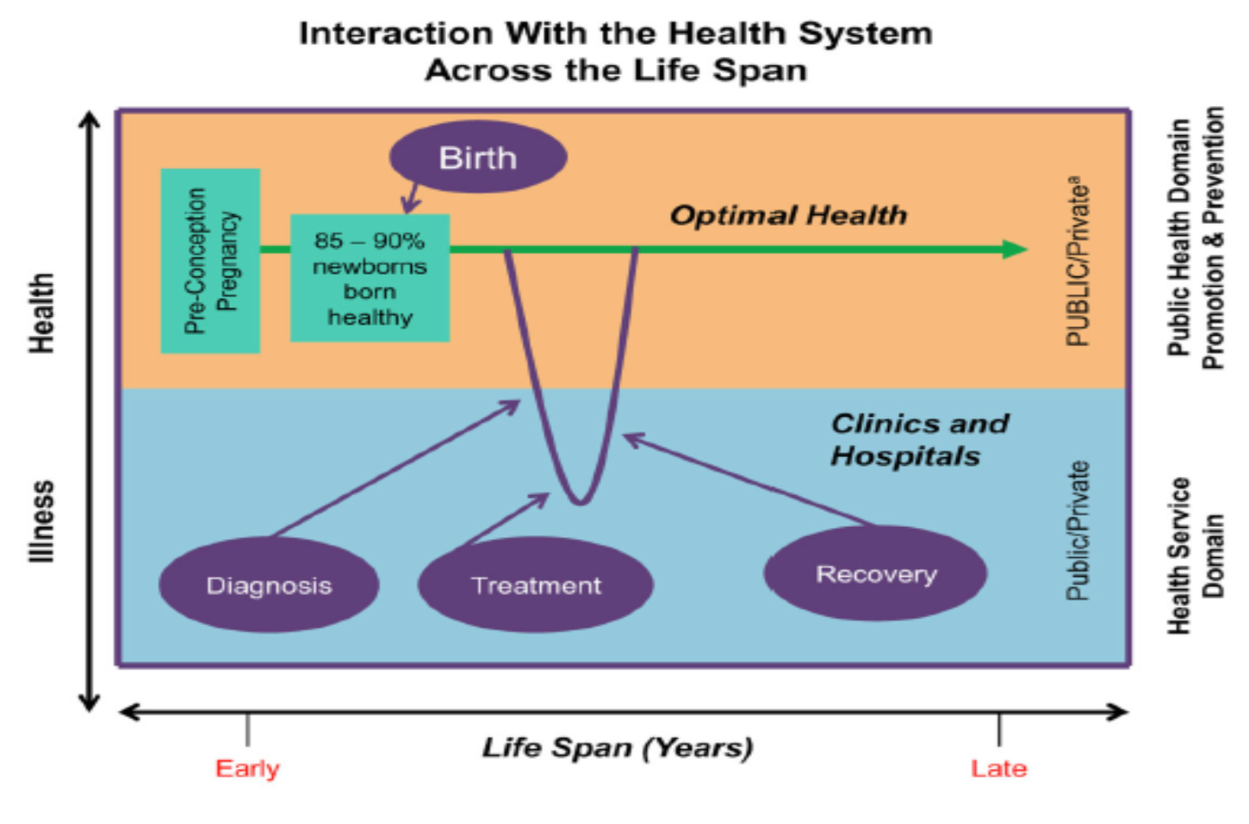
The Great Escape
* UK Public sanitation law in 1848
Health Promotion and Prevention
UHC
Provides social security against return to health
$

Slide 15
Good old Sin taxes
Limited experience on ear-marked sin taxes in Africa. South Africa Sugar tax new

Slide 16
The toxic environment
Health Promotion and Prevention
UHC
Provides social security against return to health
$

Slide 17
Challenges
Success of health promotion is invisible, lacks drama, prolonged behavior change and delayed – Ribbon-cutting healthcare
Statistical lives have little emotional effect – headlines NOT trendlines
Avoidable harm is accepted as normal – Banange!
Prevention expected to give a net financial return while treatment is expected only to be worth its cost – Bambi, give us a break!
Barriers – commercial interests, personal, religious or cultural beliefs

Slide 18
Responsive health system architecture
Courtesy: Githinji Gitahi
Equity
Focus on the most vulnerable first
Innovation
New ways; New efficiencies
Prevention
Keep people health; sickness is expensive
Frontline health workers
Data enabled Nurses, midwives and Community Health Workers
Three shifts
1. Keep communities healthy through promotive and preventive care
2. Identify needs for intervention and refer early
3. Affordable and accessible primary healthcare
Continuum of care with rising formalization and costs and decreasing trust
Level 1 -UNPAID
Community
Community Health workers
Level 2 - PAID
Dispensary
Nurses
Level 3 - PAID
Health Centre
Doctors and nurses
Level 4 - PAID
District Hospital
Specialists, GPs & Nurses
Level 5 - PAID
Referral Hospital
Specialists, GPs & Nurses
Level 6 - PAID
Referral Hospital
Specialists, GPs & Nurses

Slide 19
Core principles to observe
Health Promotion
-
As a national prosperity agenda
Ownership
-
People/communities as creators of health
Equity
-
No one left behind – rural and urban alike
Human rights and gender
‘Those with little in life deserve more in law’
Intra-sectoral and Inter-sectoral collaboration
-
Health in all policies
Mutual accountability and responsibility
-
Just do it!
Source: Africa Health Promotion Strategy 2012

Slide 20
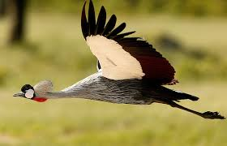
‘The Great Escape to prosperity’

Slide 21

Thank you
Dr. Githinji Gitahi
Global CEO – Amref Health Africa
Co-Chair UHC2030
Email: Githinji.Gitahi@Amref.org
Website: www.amref.org
Acknowledgements:

